Slide 1

SJSU Spring 2020 EE122 lab section #5 lab 1
Introduction to PCB design
Electronic Design Automation (EDA) software package
DipTrace
TA: Wen Zhi Qian
Email: wenzhi.qian@sjsu.edu

Slide 2
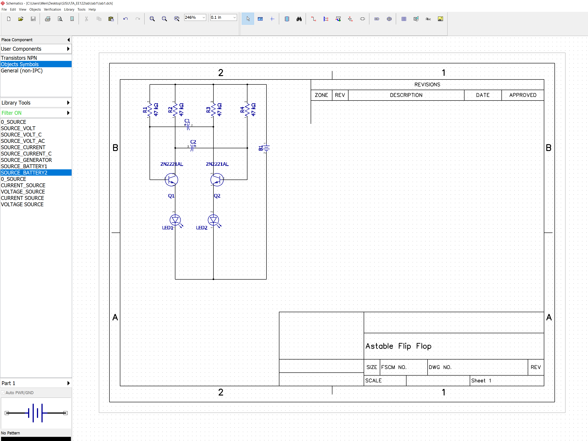
Part 1 create simple schematic with practicing DipTrace software features

Slide 3
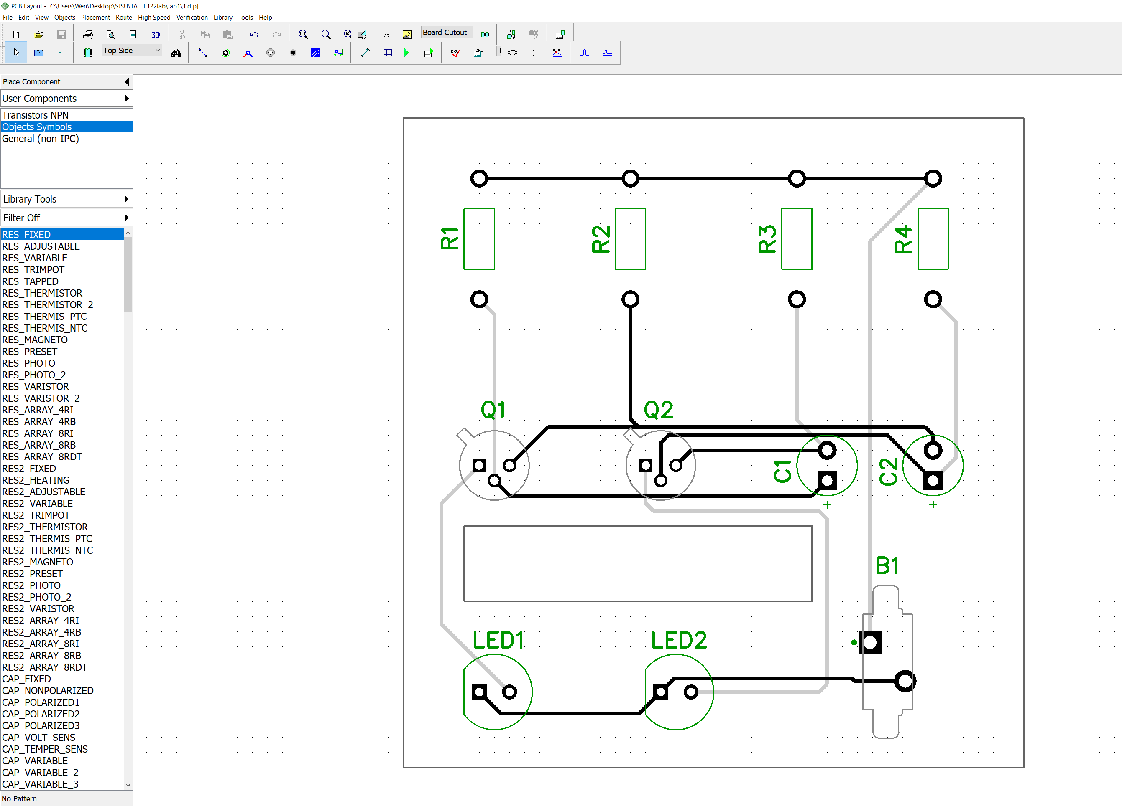

Slide 4
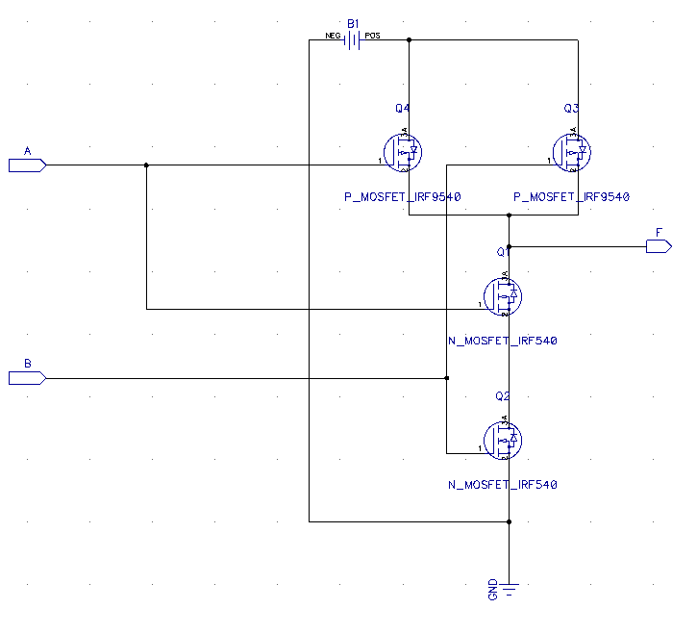
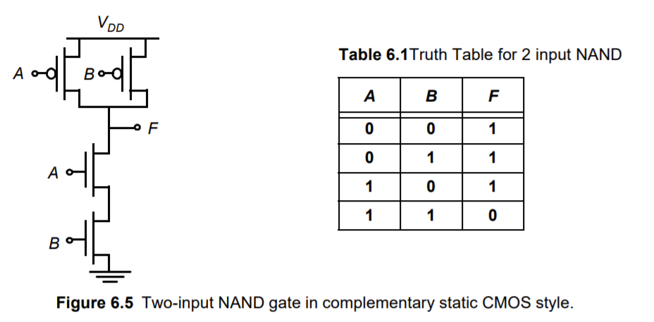
Part 2 Design a 2-input NAND gate using 2 PMOS (your choice) transistors and 2 NMOS (your choice) transistors. Use a double layer board with through hole parts.
Look for MOSFET (select N-MOS and PMOS), source (use battery 2) and GND in all libraries
Choose component, use filter and look for port (select Port_In2 and Port_Out2
Figure shows The NAND gate schematic using n-MOS and p-MOS

Slide 5
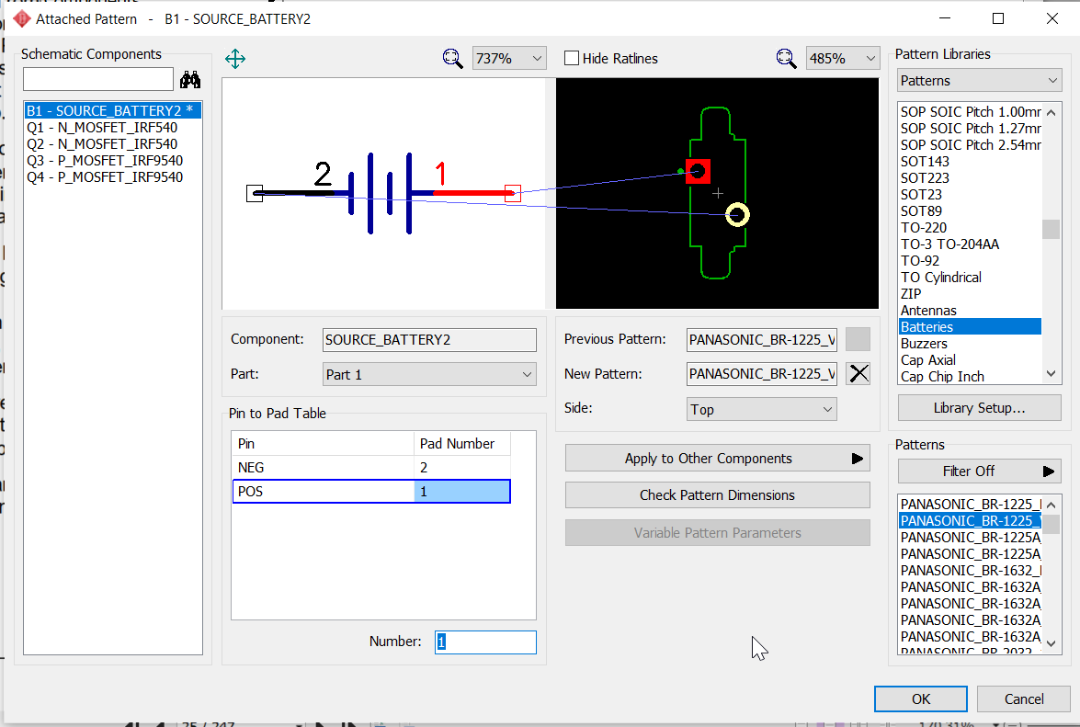
Before routing you need to select battery type

Slide 6
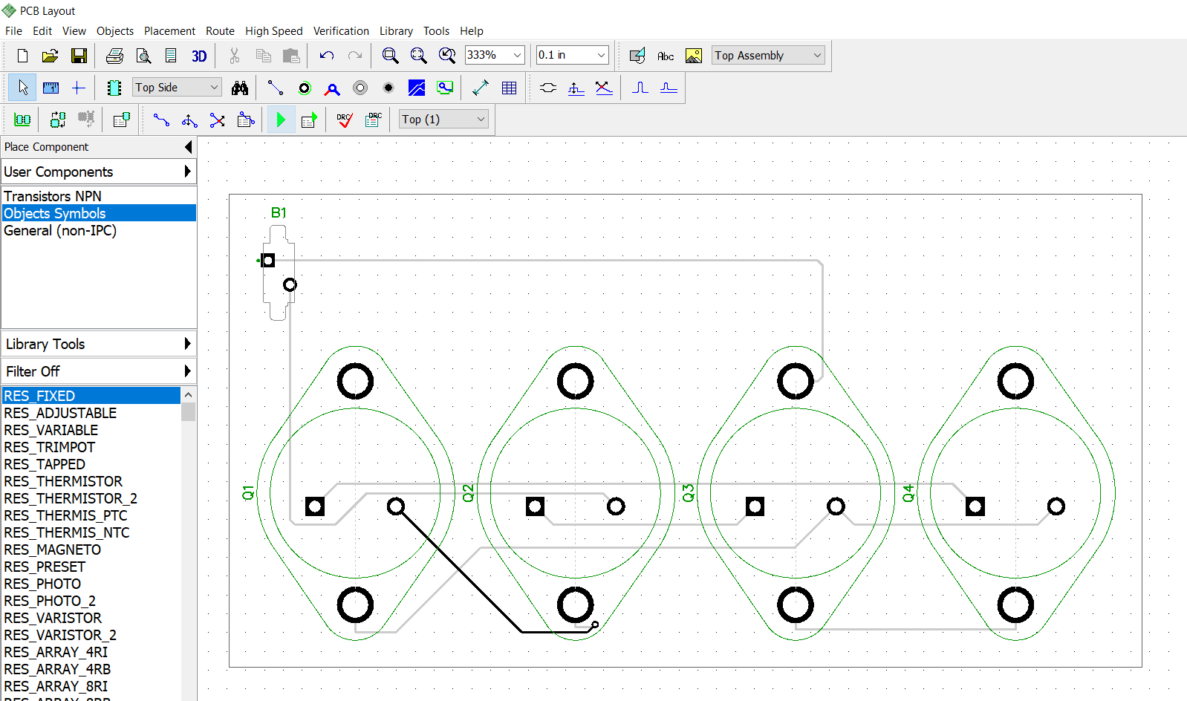
Routing
2. Run Autorouter
1. Arrange Components
Routing of the NAND gate PCB design using n-MOS and p-MOS

Slide 7
SJSU Spring 2020 EE122 lab section #5 lab 2
Introduction to Circuit Simulation (LTspice)
Industry standard circuit simulation tool
LTspice
TA: Wen Zhi Qian
Email: wenzhi.qian@sjsu.edu

Slide 8
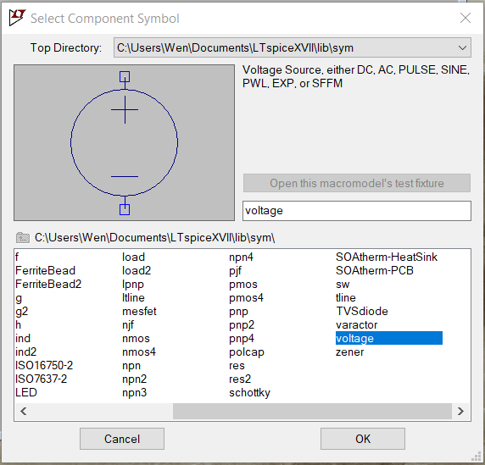
Part 1
Add other components – Press “F2” or click the component button to insert a component. A “Select Component Symbol” window will open. Take a minute to browse through the list of available components. Note that sources are labeled as “current” and “voltage”.
Select the component that you want to add and click “OK”. If you want to rotate the component before placing, press “ctrl+R” or click the rotate button. Left click where you want to place the component. Press “esc” to quit adding this component.

Slide 9
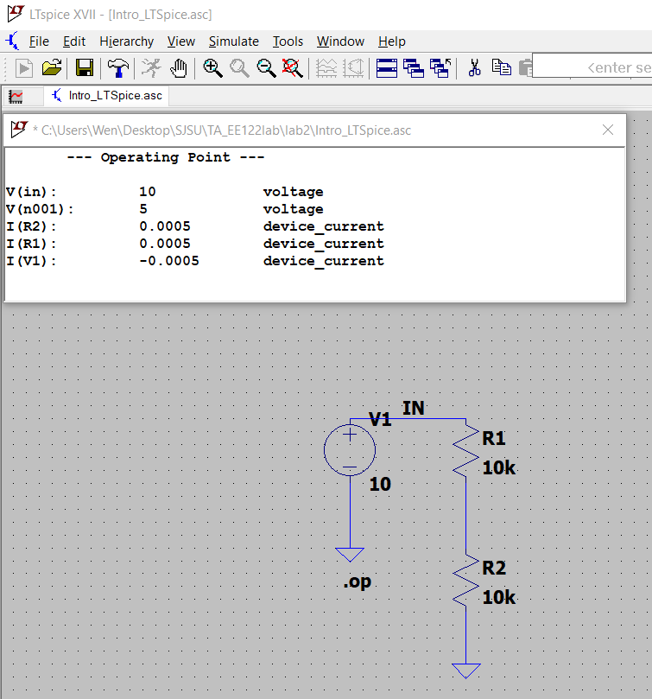

Slide 10
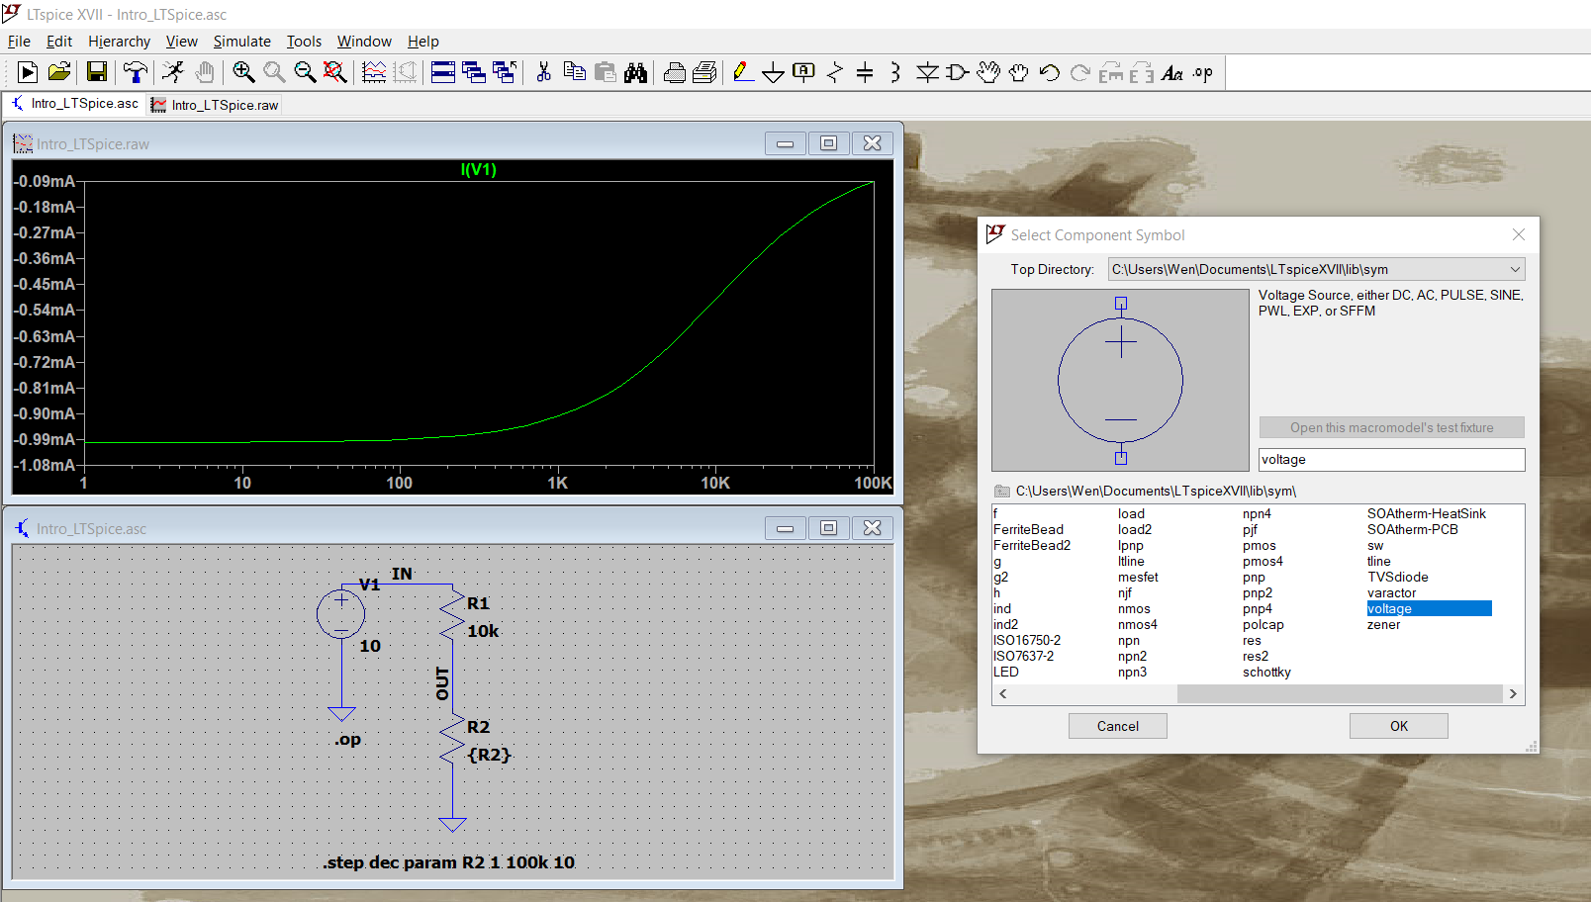
Click component

Slide 11
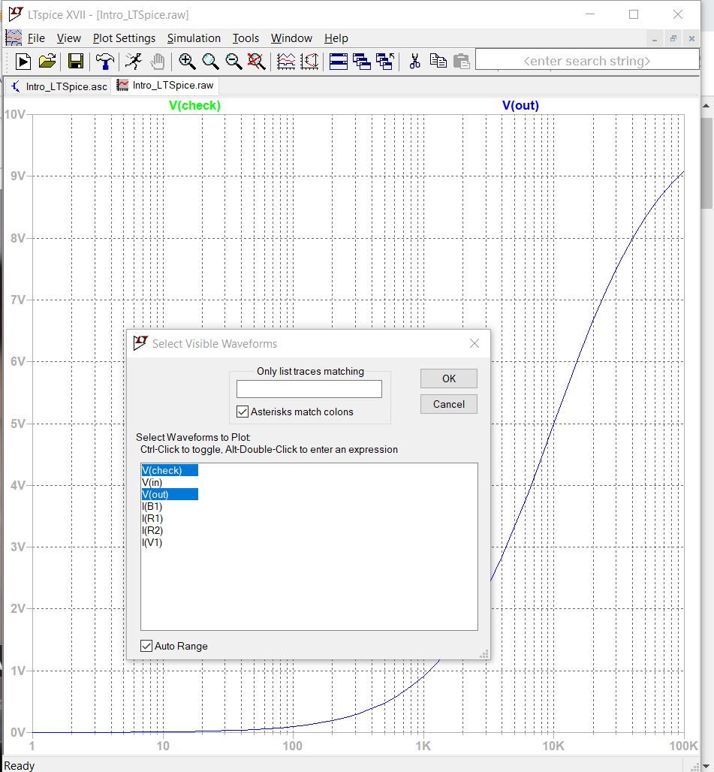
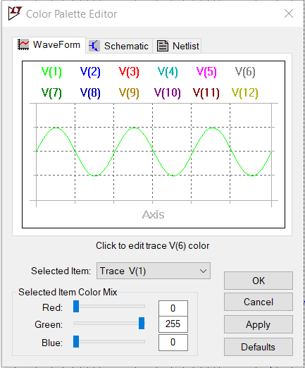
Make sure:
The graph horizontal axis is in logarithmic
Background is white (go to Tools -> Color Preference)
Add grid (Plot Settings -> check Grid)
Pick visible traces
Click ctrl to select both V(check) and V(out)
The graph in your report should all have white background

Slide 12
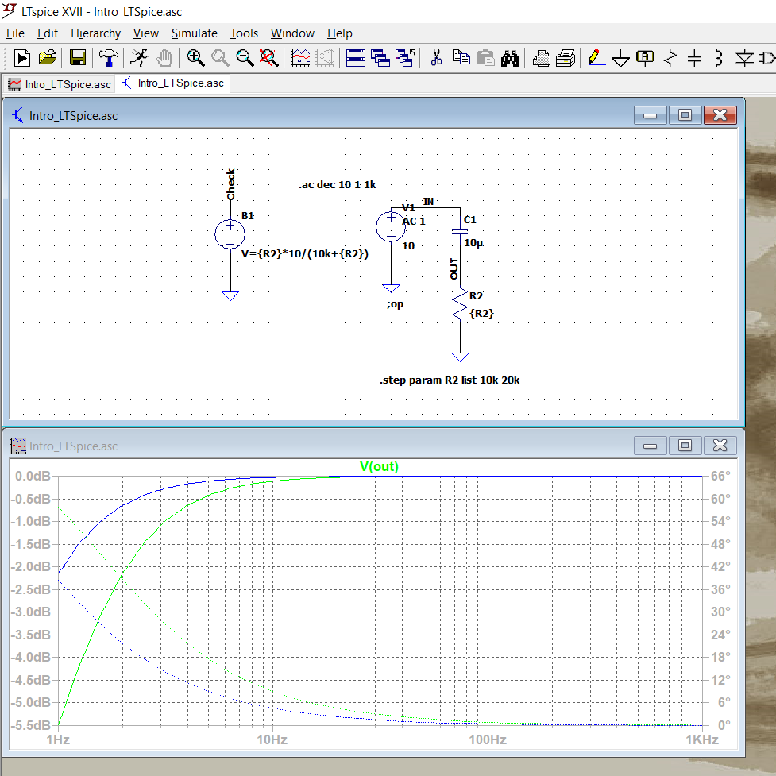

Slide 13
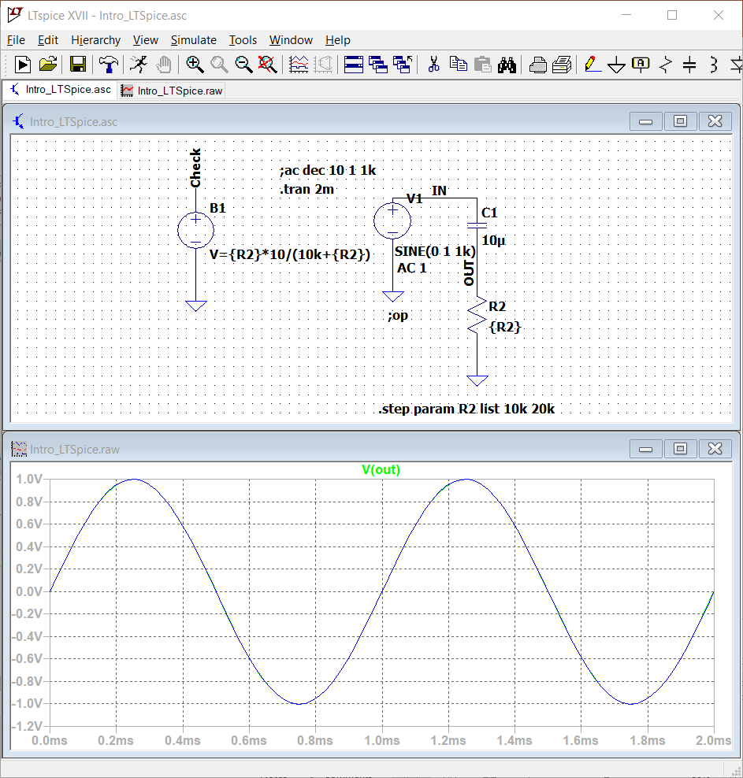
transient simulation of 2mS
Transient response

Slide 14
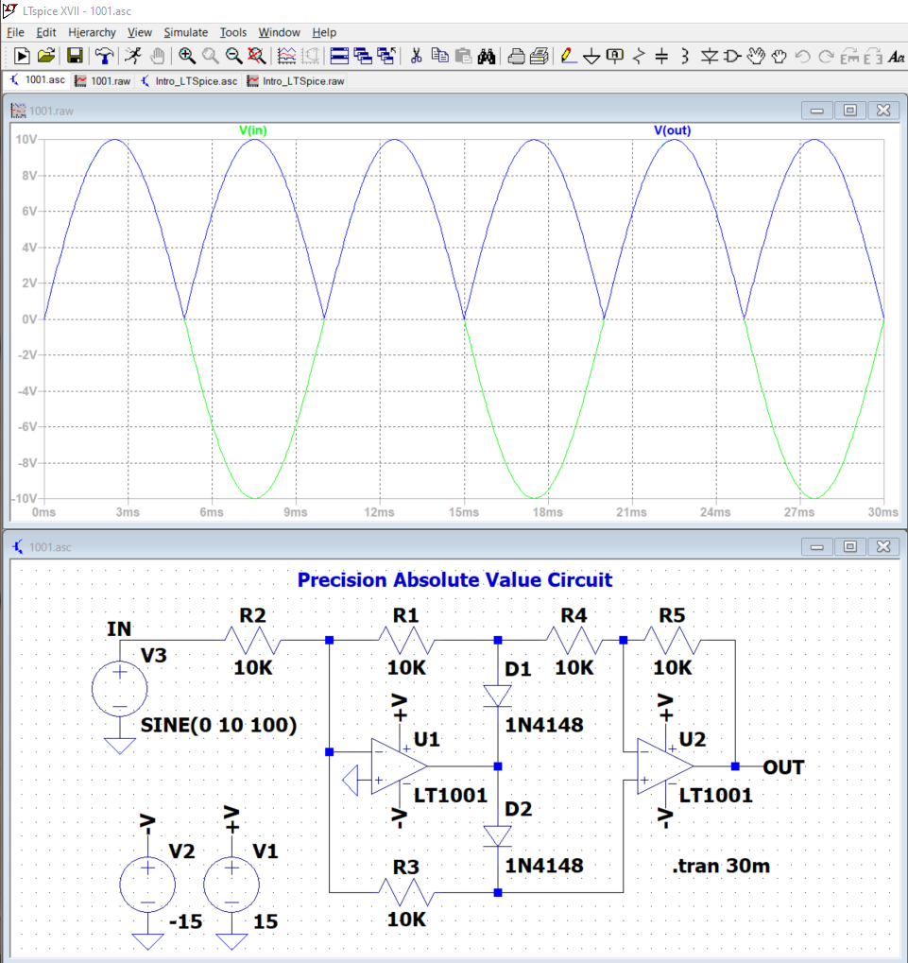
Transient result
Precision Absolute Value Circuit

Slide 15
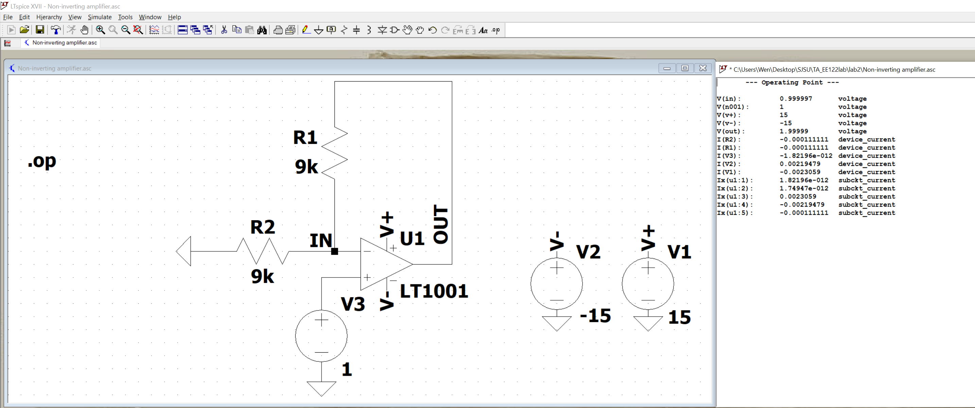
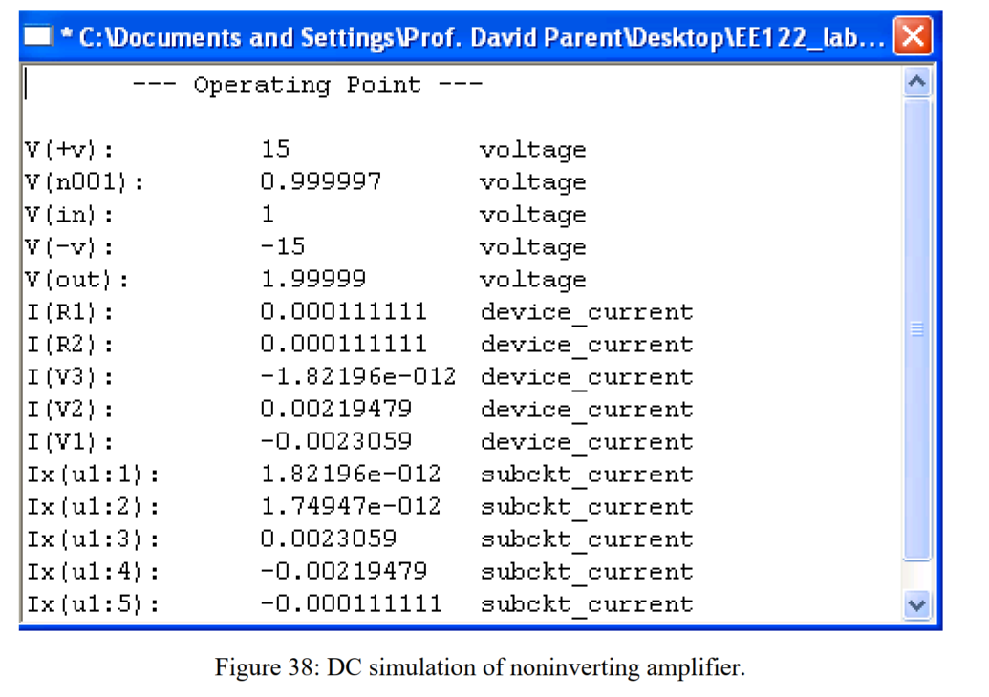

Slide 16
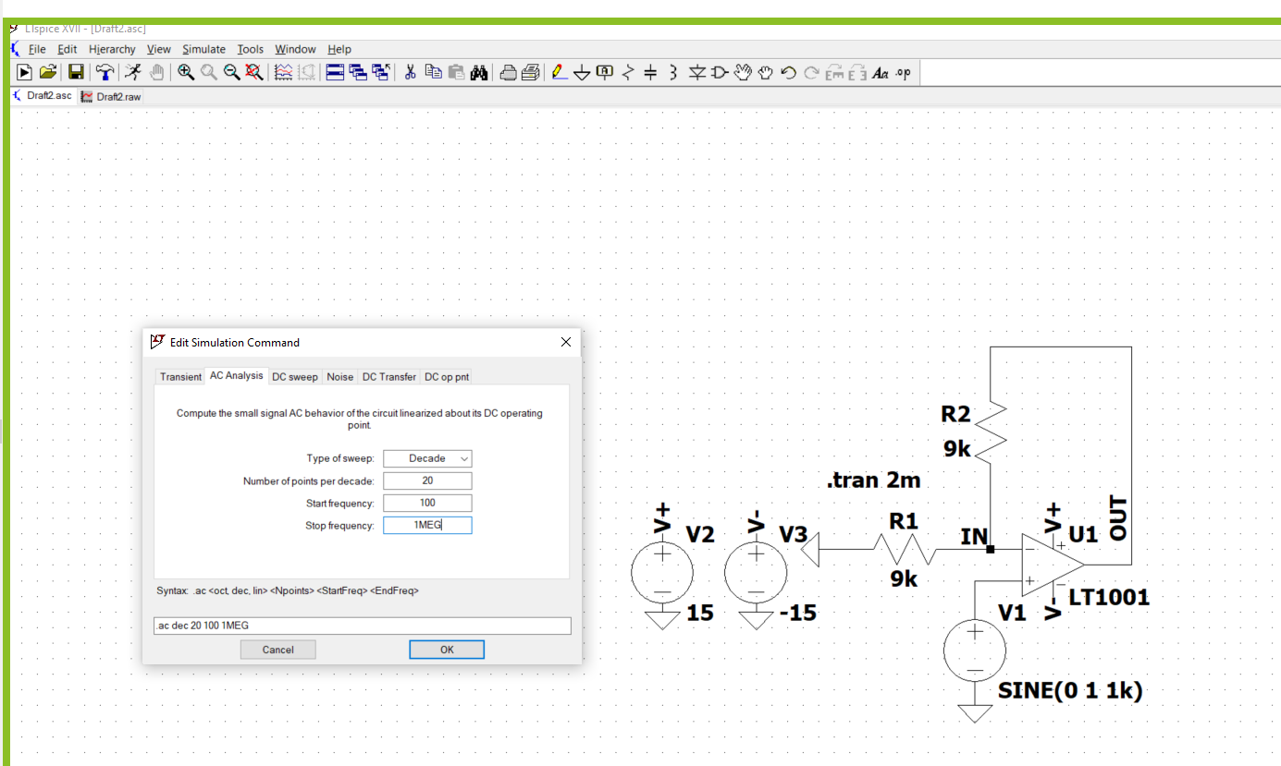
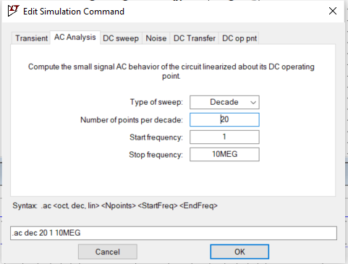
Right click

Slide 17
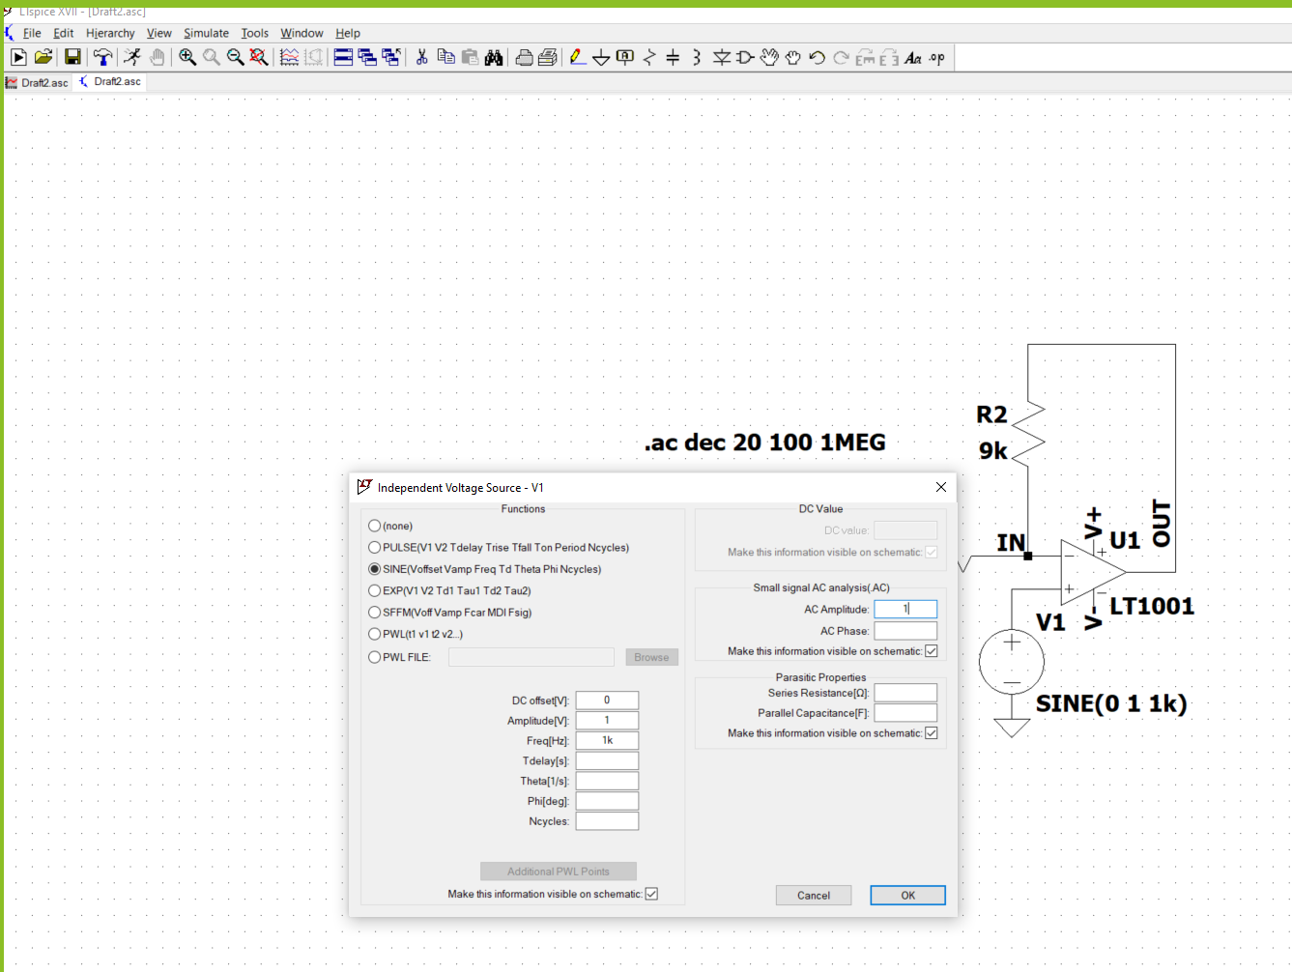
Right click
Then run simulation

Slide 18
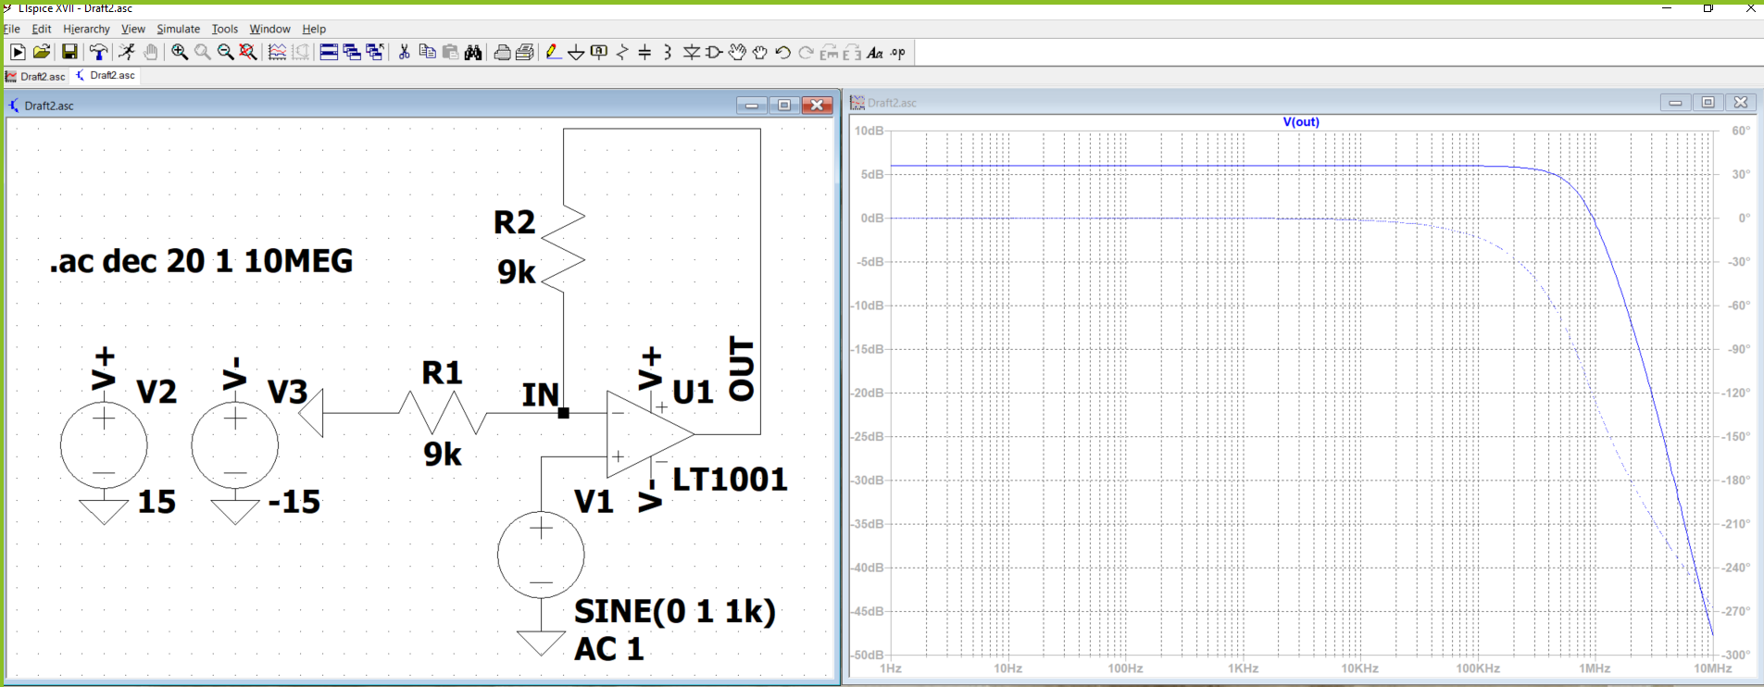
Non-inverting amplifier
Bode Plot of Noninverting amplifier

Slide 19
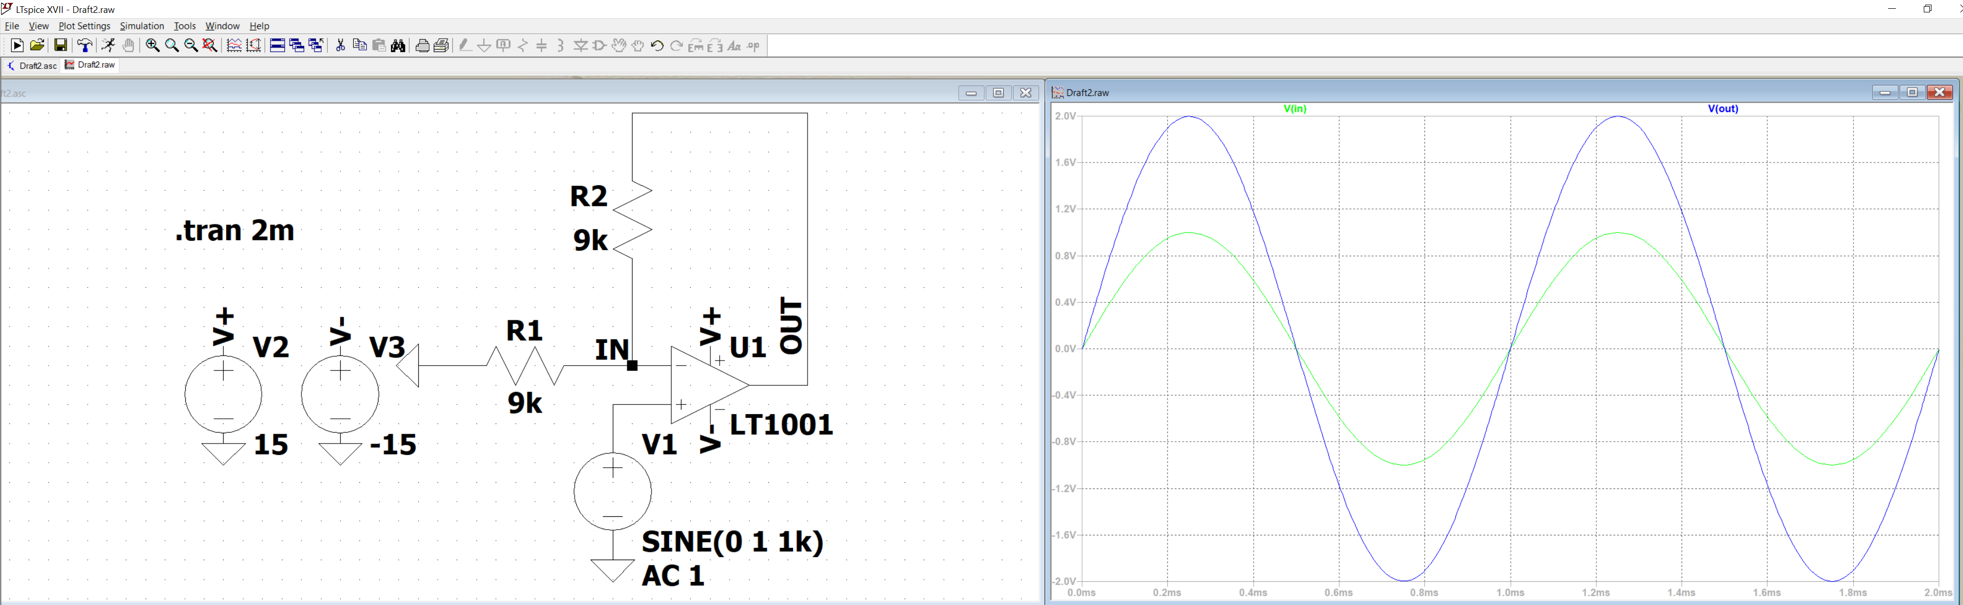
Transient results of non-inverting amplifier

Slide 20
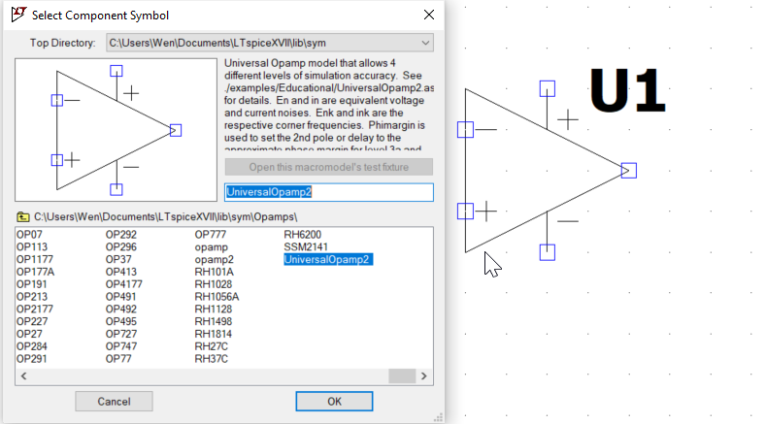
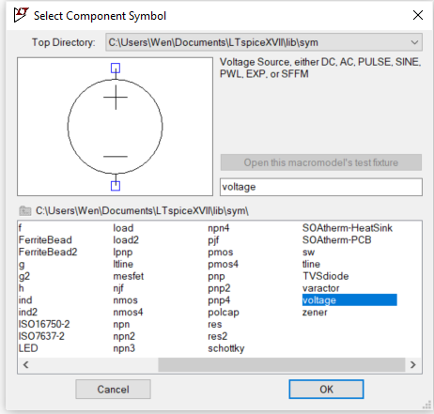
Part 2
Inverting amplifier using the same R values

Slide 21
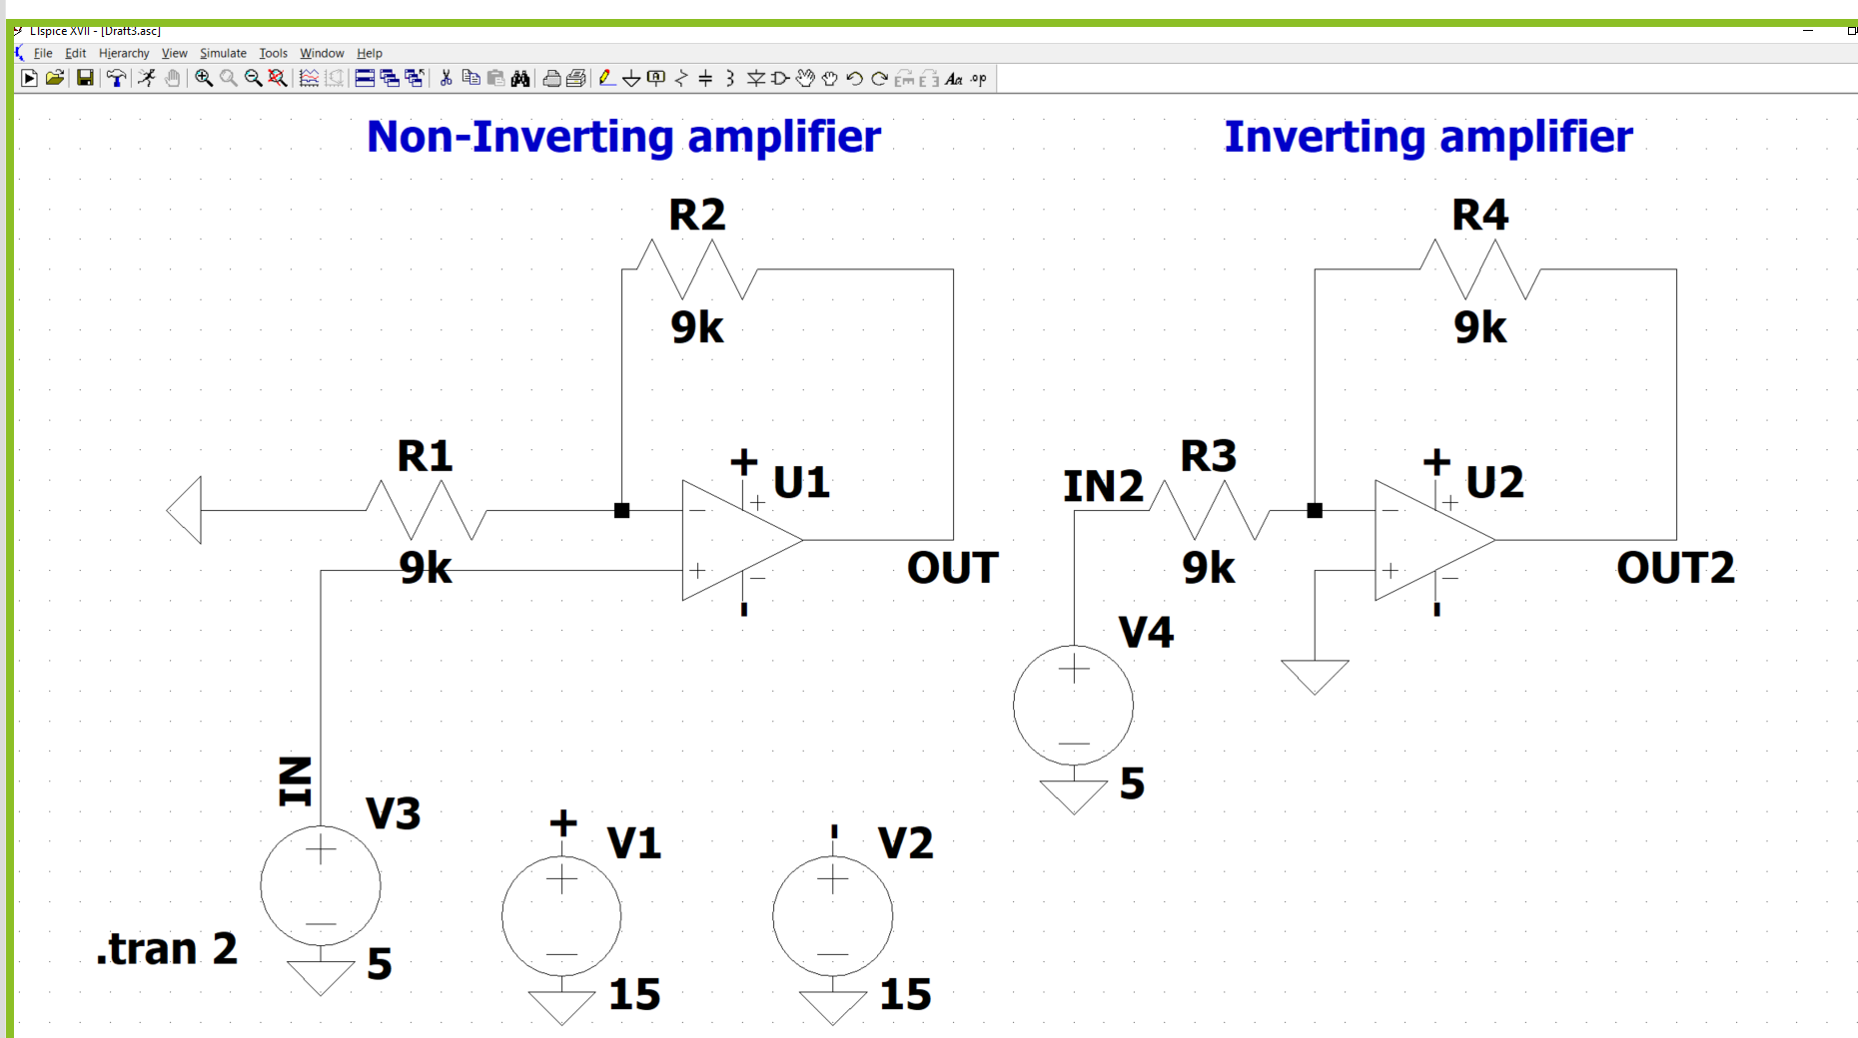

Slide 22
SJSU Spring 2020 EE122 lab section #5 lab 3
Solar Cell Modeling and Applications
No lab report due
5 check point to show to your TA before you leave
TA: Wen Zhi Qian
Email: wenzhi.qian@sjsu.edu

Slide 23
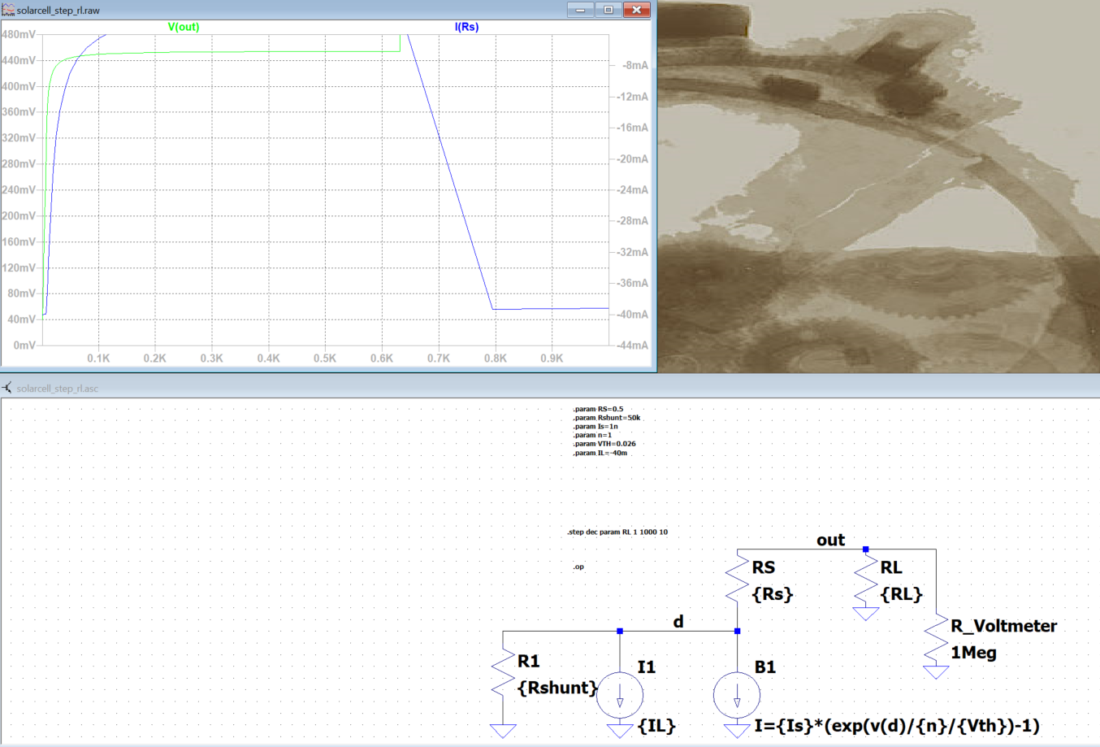
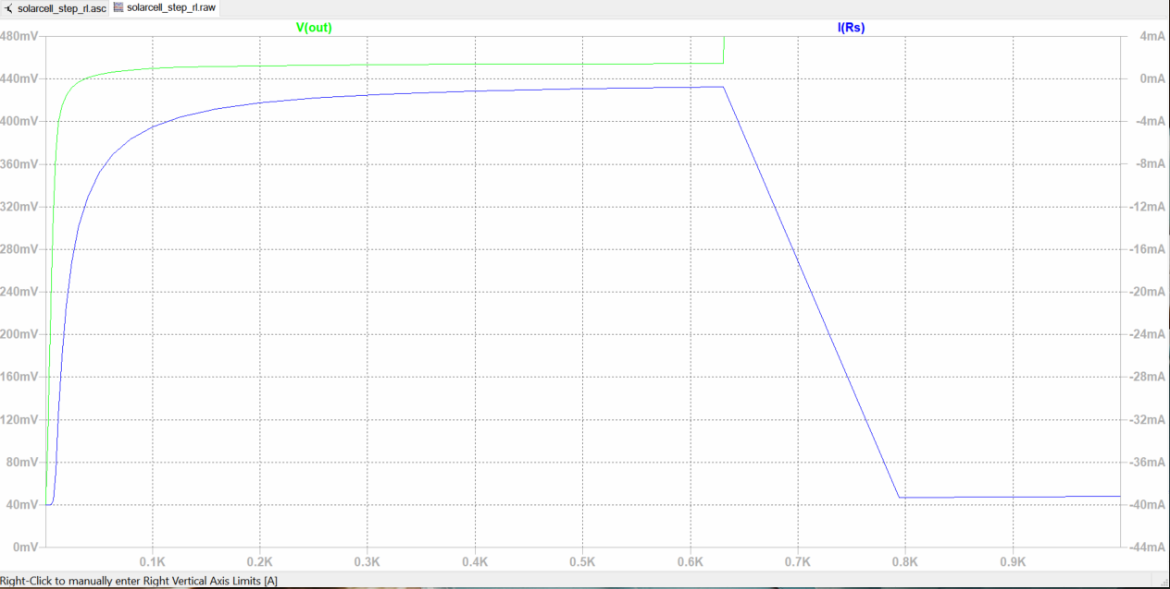
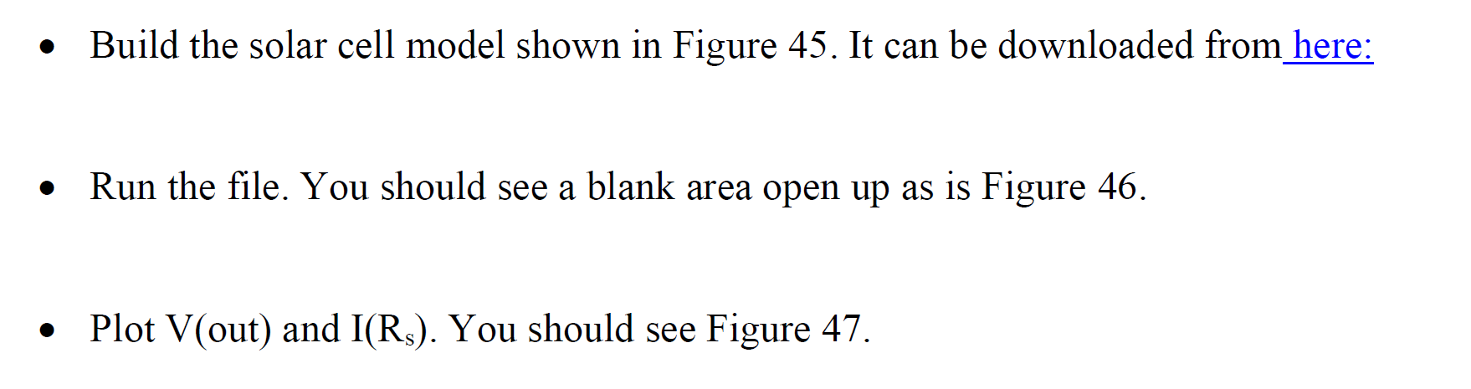
TA checkpoint A start
Simulation results of Vout and I(rs) vs Rload.
This figure is wrong.
Look the correct figure on left
Change 1000 to 600

Slide 24
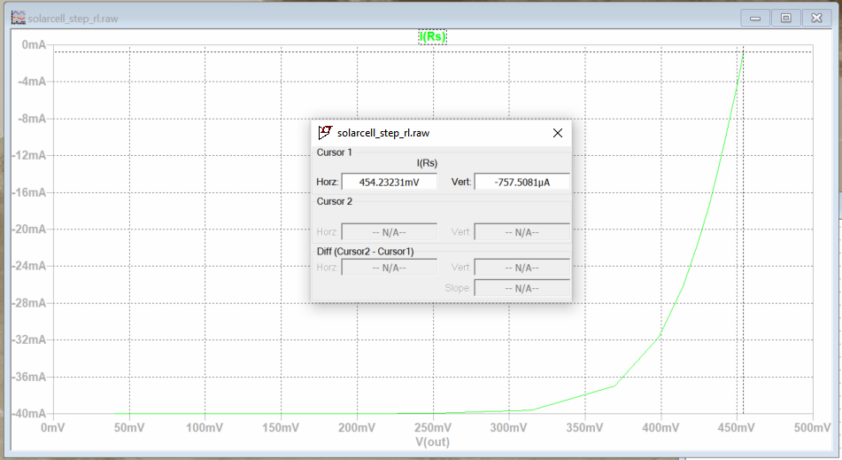
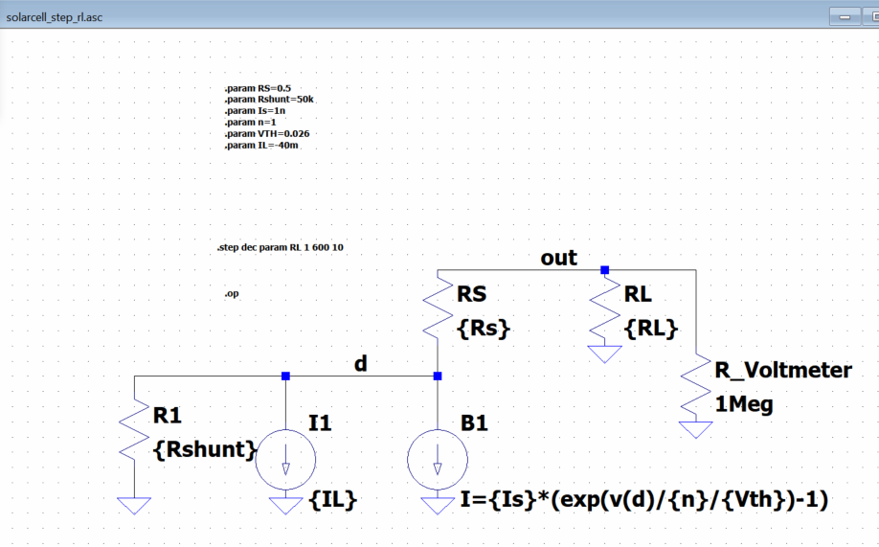
Step 1. Left click here
Step 3. Move the verticle dot line close to this point
Step 4. You will see this window pop-up
Step 2. Left click here
Finding Voc and Isc

Slide 25
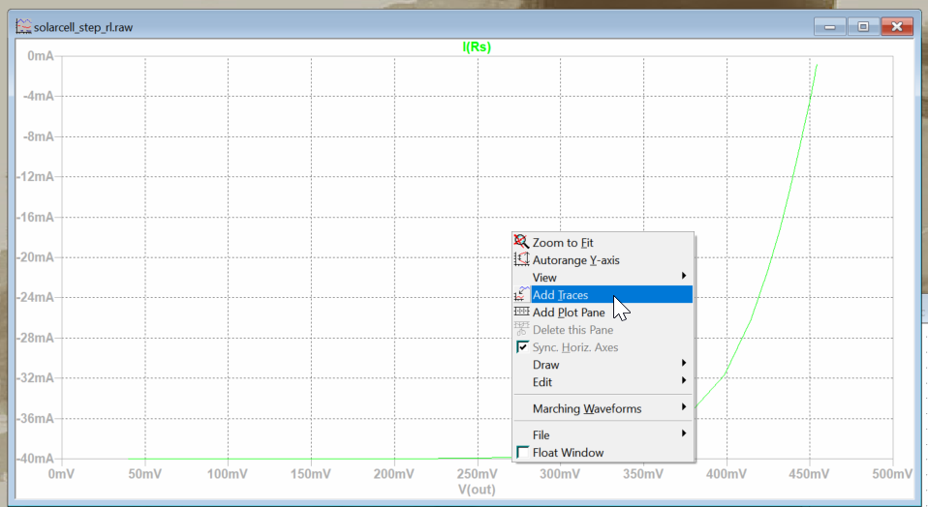
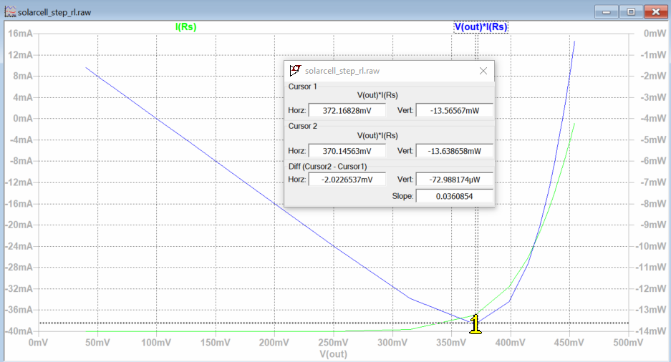
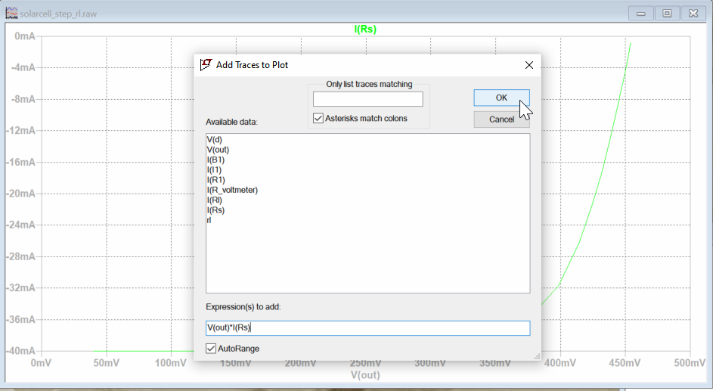
TA checkpoint A finished
Right click and select “Add trace”
Left click here
Maximum power at this point, even through V(out)*I(Rs) are different sign cause power shows as negative number
Finding maximum available power.

Slide 26
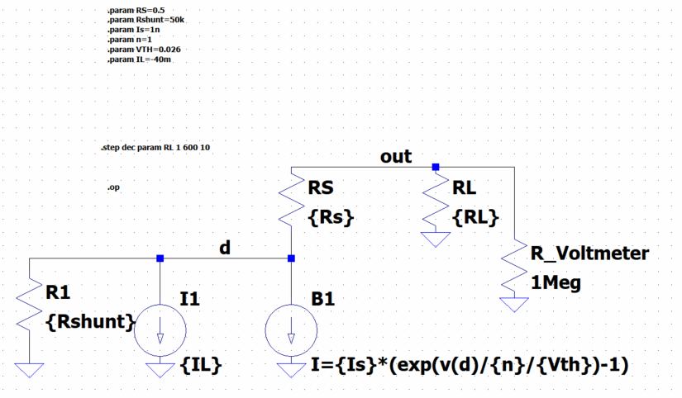
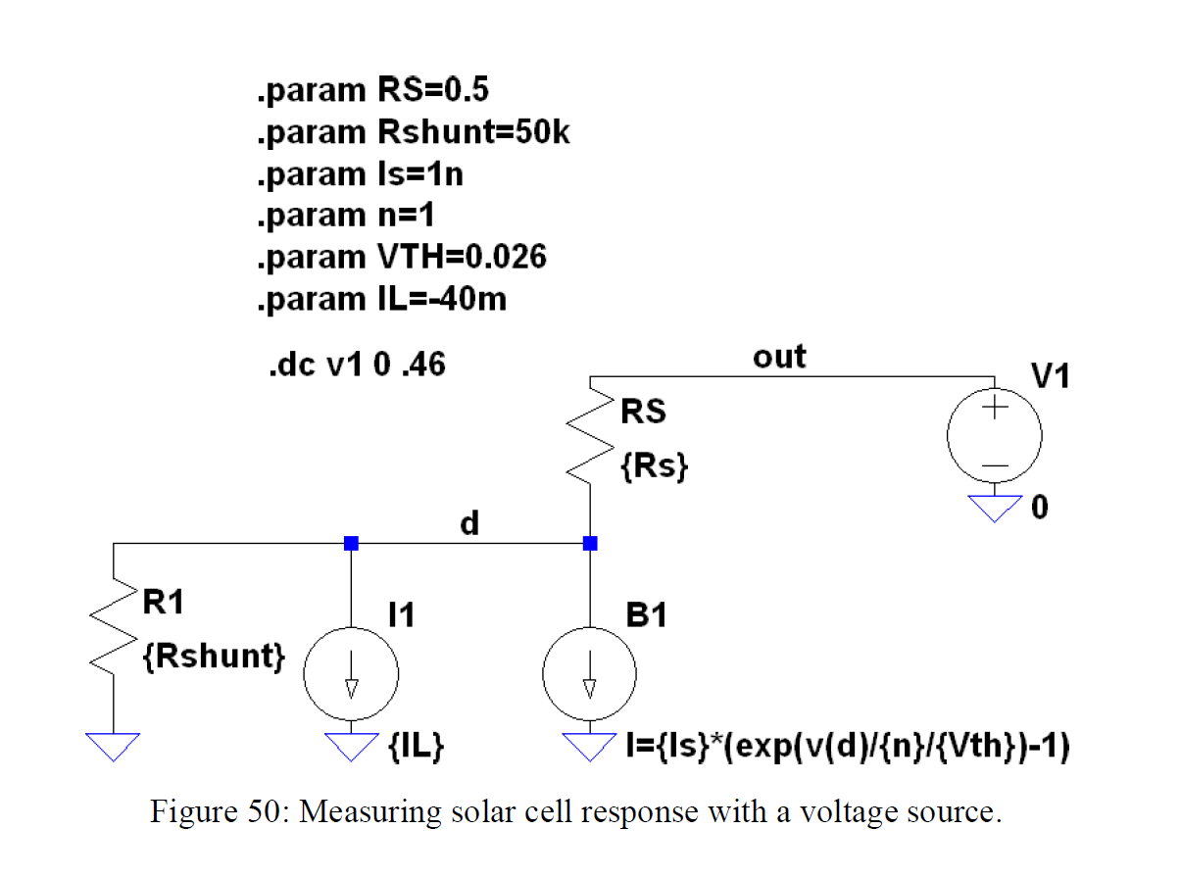
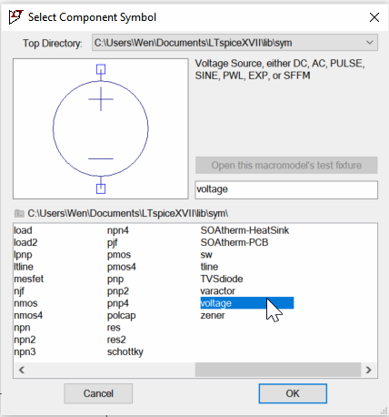
TA checkpoint B start
Click “delete” button on your keyboard and cut the parts need to change
Select “Component” and add “Voltage”
Delete the “.step xxx” and “.op”
Write new “.dc xxx”
Change to
Remember add new voltage value

Slide 27
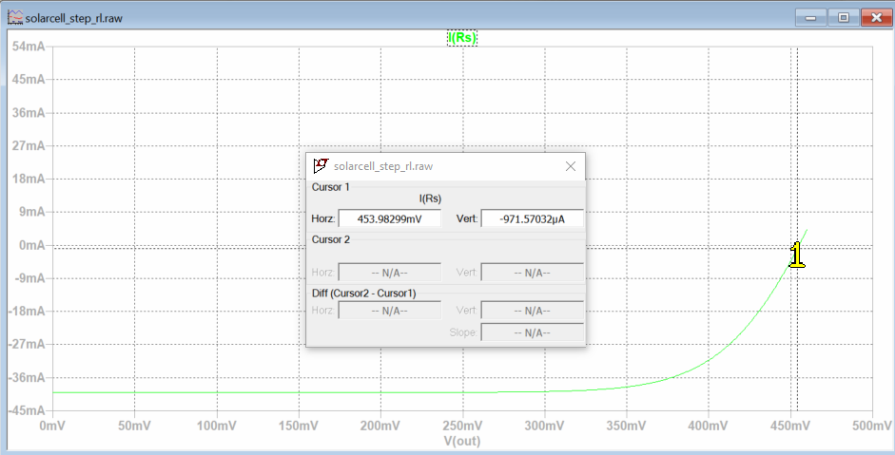
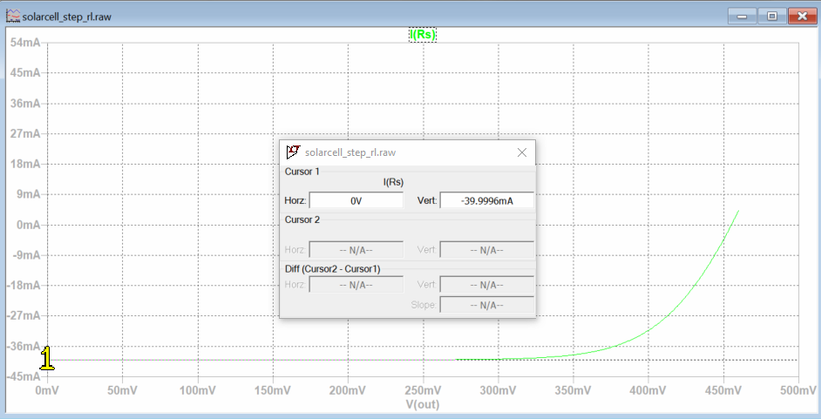
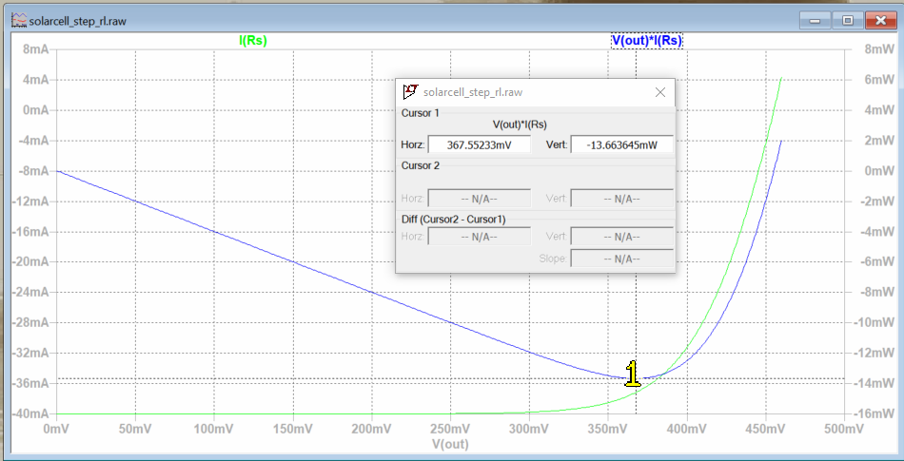
Run simulation
Figure 51. Measuring Voc and Isc from a swept voltage source.
TA checkpoint B finished
Figure 52. Finding power from a swept voltage source.

Slide 28
SJSU Spring 2020 EE122 lab section #5 lab 3
Solar Cell Modeling and Applications
No lab report due
5 check point to show to your TA before you leave
TA: Wen Zhi Qian
Email: wenzhi.qian@sjsu.edu

Slide 29
A

Slide 30
TA checkpoint A start
Simulation results of Vout and I(rs) vs Rload.
This figure is wrong.
Look the correct figure on left
Change 1000 to 600

Slide 31
Step 1. Left click here
Step 3. Move the verticle dot line close to this point
Step 4. You will see this window pop-up
Step 2. Left click here
Finding Voc and Isc

Slide 32
TA checkpoint A finished
Right click and select “Add trace”
Left click here
Maximum power at this point, even through V(out)*I(Rs) are different sign cause power shows as negative number
Finding maximum available power.

Slide 33
B

Slide 34
TA checkpoint B start
Click “delete” button on your keyboard and cut the parts need to change
Select “Component” and add “Voltage”
Delete the “.step xxx” and “.op”
Write new “.dc xxx”
Change to
Remember add new voltage value

Slide 35
Run simulation
The open-circuit voltage, V_{OC}, is the maximum voltage available from a solar cell, and this occurs at zero current.
Figure 51. Measuring Voc and Isc from a swept voltage source.
TA checkpoint B finished
Νοτε
• Iload is the photo generated current.
• Isc is the current the cell produces at zero bias (0 voltage).
• Rs is the series resistance of the solar cell.
• Is is reverse saturation current of a diode.
• n is the ideality factor of a diode usually between 1-2.
• Voc is open circuit voltage of a solar cell.
• Vth is the thermal voltage (KT/q = 26mV) at room temperature.
Figure 52. Finding power from a swept voltage source.

Slide 36
C

Slide 37
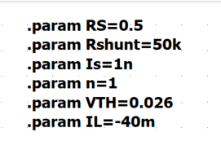
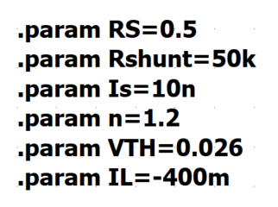
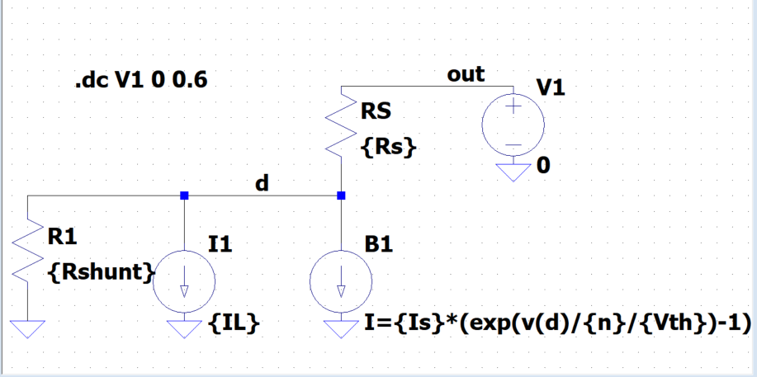
TA checkpoint C start
Change end point Voltage so you can see the simulation at 0 mA

Slide 38
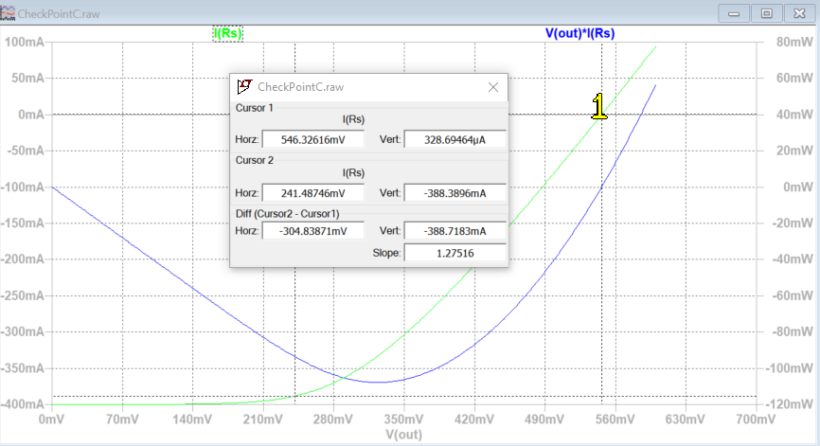
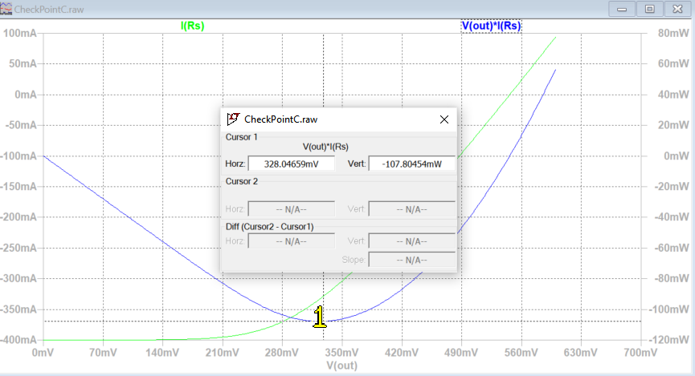
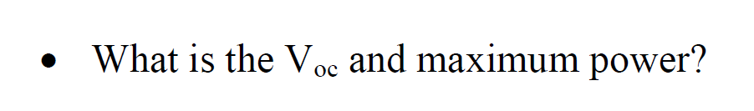
Run simulation
Measuring Voc from a swept voltage source.
Finding power from a swept voltage source.

Slide 39
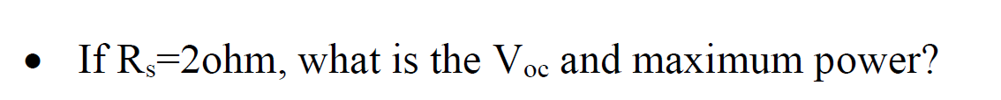
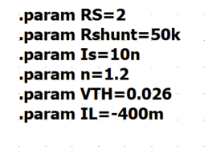
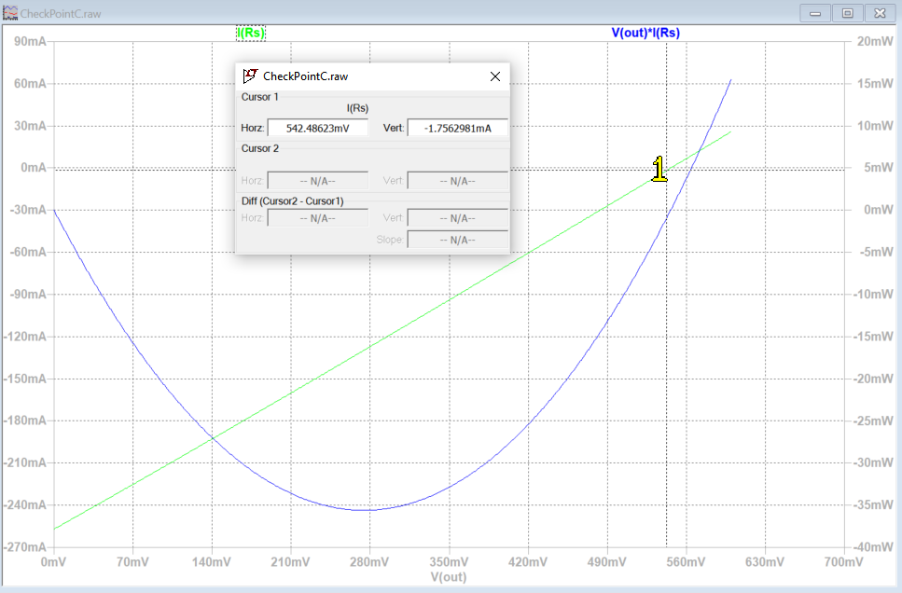
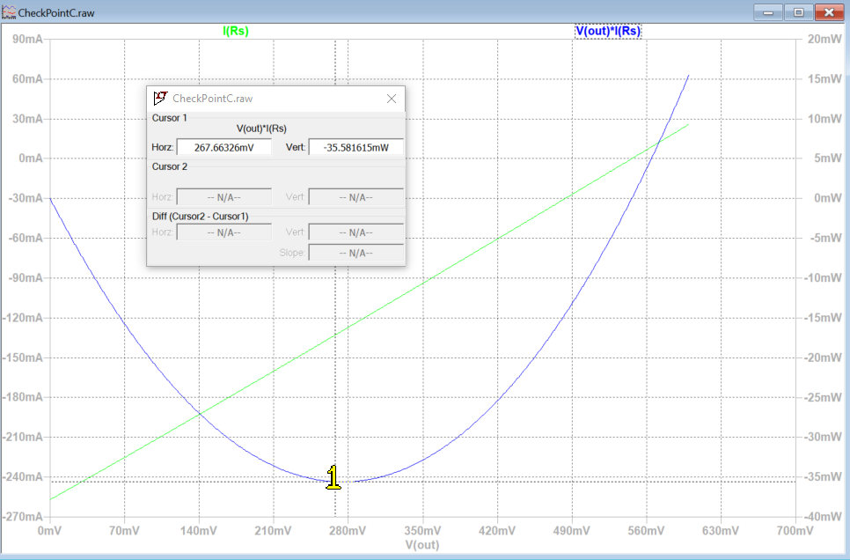
TA checkpoint C finished
Run simulation
end point Voltage 0.6V
Measuring Voc from a swept voltage source.
Finding power from a swept voltage source.

Slide 40
D
Energy Harvesting

Slide 41
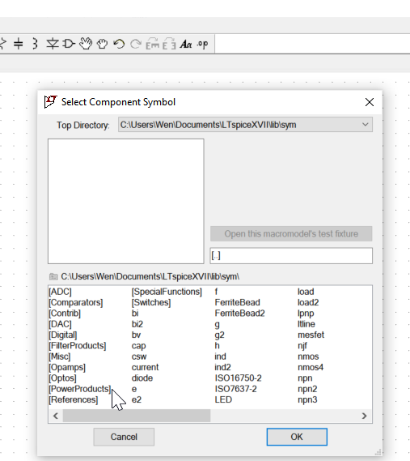
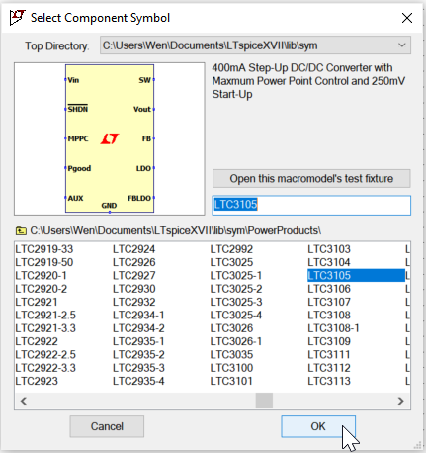
TA checkpoint D start
Step 1. Left click here
Step 3. Type in LTC3105
Step 2. Left double click here
Step 4. click ok

Slide 42


Step 2. select open up test jig here
Step 1. Right click here

Slide 43

TA checkpoint D finished
Figure 53: LTC3105 Test Jig.
Figure 54: Transient response of LTC3105.

Slide 44

E
You need to add source to previous graph

Slide 45

TA checkpoint E start

Slide 46

Run simulation
You are making a solar power source which provide 3.3V. You can also modify it further to provide 5V.
TA checkpoint E finished
Transient response

Slide 47
The END

Slide 48
SJSU Spring 2020 EE122 lab section #5 lab 4
Energy Harvesting PCB Design
No lab report due
Check your design with your TA before you leave
Diptrace files.s needs to be submitted
TA: Wen Zhi Qian
Email: wenzhi.qian@sjsu.edu

Slide 49


GND
Use PCB layout might be easier for making this

Slide 50





Step 3. Place copper pour
Step 2. Place board outline
or
Step 1. Place all needed 3x capacitors (search 0805 in all libraries) and 3x resistors (search 0402 in all libraries).

Slide 51


Change the board outline size to 3’’ x 2.5”

Slide 52


Change the copper pour size to 2” x 2”

Slide 53


Note: This USB might not be in your new version of Diptrace library. You will need to download the old version library if that is the case.
Here is the tutorial for downloading old version library.

Slide 54



https://diptrace.com/download/older-versions/
Download to your computer and unzip it
Click Add

Slide 55



Add the directory of your unzipped folder, click ok
Position it

Slide 56



Slide 57



Choose manual routing
On right change properties
+

Slide 58


Note

Slide 59


Place your name on the design
Method #1

Slide 60

Place your name on the design
Method #2

Slide 61
The END

Slide 62
SJSU Spring 2020 EE122 lab section #5 lab 5
Diode Modeling and Applications
LTspice is required
TA: Wen Zhi Qian
Email: wenzhi.qian@sjsu.edu

Slide 63
Part A

Slide 64


Start from building this circuit
Figure 64: Diode DC test setup
Figure 65: DC results for diode circuit. (Make sure to change the x-axis to V(out) or you will get a plot like Figure 66)

Slide 65





Diodes formula
This is I0, we are asking
This is n, we are asking
$$I= I_{0} × e^{\frac{V}{nV_{T}}}$$
For easier calculation we get rid of -1 term
$$ln(I)=\ln{(I_{0} × e^{\frac{V}{nV_{T}}})}$$
Take ln on both side
$$ln(I)=\ln\left(I_{0}\right)+ ln⁡( e^{\frac{V}{nV_{T}}})$$
$ln\left(I\right)=\ln\left(I_{0}\right)+\frac{1}{nV_{T}}V$

Slide 66





$$ln\left(I\right)=\ln\left(I_{0}\right)+\frac{1}{nV_{T}}V$$
$\ln\left(I_{0}\right)$= $ln\left(I\right)−$ $\frac{1}{nV_{T}}V$
Slope m
Thermal Voltage $V_{T}=0.0259$
In(I)= -11
$\ln\left(I_{0}\right)$= -11-21.916$×$0.4V
$\ln\left(I_{0}\right)$= - 19.7664
$I_{0}$ = $e^{−19.7664}=2.6×{10}^{−9}$
=$\frac{1}{21.916×0.0259}$ $=1.76173$
V=400mV
Figure 65: DC results for diode circuit. (Make sure to change the x-axis to V(out) or you will get a plot like Figure 66)

Slide 67

Go back to your schematic to check the calculation if it is correct
1. Left click and place anywhere
3. left click
2. Right click
Is=2.52n and N=1.752 close to the results

Slide 68



Build the following circuit with the previous calculated results
$I_{0}$ = $e^{−19.7664}=2.6×{10}^{−9}$
Rs=0.568Ω(from Ltspice parameter data)
N $=1.76173$

Slide 69


q4. Run simulation and compare the current through RS and D1.
Are they the same?
What are possible sources of error?
q5. What is the voltage input range for which this diode can be used
as an $e^{x}or ln⁡(x)$ function in an opamp based circuit?
Put your explanation in the report.

Slide 70
PART B

Slide 71





1. Connect the NATURAL LOG AMPLIFIER physically 2. Verify your design in LTSpice
notch
LT1006 pin config
V+
1+ or 2+
W1
gnd
V -
1N4148 Diode, black band represents cathode (-)
5 connections from your circuit to ADALM2000
LT1006 op-amp datasheet:
https://datasheetz.com/data/Integrated%20Circuits%20(ICs)/Amplifiers%20-%20Instrumentation,%20OP%20Amps,%20Buffer%20Amps/LT1006CN8-datasheetz.html

Slide 72


Please try to search ADALM2000 tutorial (recommend youtube)
Connect you ADALM2000 (made by Analog Devices) usb to your computer and open folder shown as below
Click on info
Download and install these two
https://www.youtube.com/watch?v=-ZpoaSnIGLY
You can look for some other tutorial links as well for easier understanding.

Slide 73


Adalm2000 PIN-OUT

Slide 74

Signal generator Set V(in)=5V

Slide 75

V(out) is shown in Voltmeter V(out) = - 0.585 in this graph

Slide 76

From LTspice simulation we notice when Vin = 5V, Vout = -553mV
Repeat the steps to check Vin = 1, 2, 3, 4 V

Slide 77
SJSU Spring 2020 EE122 lab section #5 lab 7
Using the gm/ID technique to design Common Source (CS) amplifiers
LTspice is required
TA: Wen Zhi Qian
Email: wenzhi.qian@sjsu.edu

Slide 78

Check point A
Extract $V_{T}$ and $K_{N}$ (illustration link)
Download NMOS part 2n7000 from link
Open it and run simulation

Slide 79









(x2,y2)
(x1,y1)
Sqrt(Id) Linearize as Y=mx+b
Slope m=0.23595=$\sqrt{\frac{K_{N}}{2}}$
$$K_{N}=0.111344805$$
$$V_{T}=−\frac{b}{m}=1.46496 V$$
$$b=y2 −mx2$$
Choose point (x2,y2)
(3.5056497 , 481.50175 * ${10}^{−3}$)
$$b=\text{481.50175 ∗ }{10}^{−3}−\text{0.23595}x\text{3.5056497}$$
$$b=−0.345656$$

Slide 80

Check point B
Extract $V_{A}$ (illustration link)
Download file from link (Note VG should be set to 2.1V)
Open it and run simulation

Slide 81




Your point should be select from this region. The NMOS is working at saturation region
.
(x2,y2)
(3.0030395 V, 473.94443 * ${10}^{−6}$ A)
XXX
Not select from this region
Slope m = 4.8823 * ${10}^{−6}$
$$y_{2}=mx_{2}+b$$
$$b=y_{2}−mx_{2}$$
$V_{A}=−\frac{b}{m}=(mx_{2}− y_{2})/m$ = $x_{2}− y_{2}/m$ = 3.0030395 - $\frac{\text{473.94443 ∗ }{10}^{−6}}{\text{4.8823 ∗ }{10}^{−6}}$ = -94.071
($V_{A}$ number changes rapidly, as long as your formula is correct you will get point)

Slide 82

Check point C
Download NMOS part 2n7000 from link
Run simulation and plot Id(M1)
Figure 74: ID vs VDS for a 2N7000 Diode Connected MOSFET.
Figure 73: Diode connected MOSFET to extract gm/ID.

Slide 83

3. Right click on the x-axis and in the quantity plotted pop-up enter in Id(M1) to plot the current. Click OK. You should see Figure 75
Figure 75: Plotting current on the x-axis.

Slide 84


4. Right click again on the x-axis and this time click plot logarithmically in the pop up. You should see Figure 76
Figure 76: Changing the x-axis to plot logarithmically.

Slide 85

5. Go to plot settings and then add trace in the pop-up type: d(Id(m1))/Id(m1). d(Id(m1)) means take the derivative of the drain current of MOSFET M1. Delete the Id(M1) current plot. You should see Figure 77
x axis should still be logarithmic
Figure 77: Non-scaled gm/ID plot

Slide 86

6. Go to plot settings and then add trace in the pop-up type: d(Id(m1))/Id(m1). d(Id(m1)) means take the derivative of the drain current of MOSFET M1. Delete the Id(M1) current plot. You should see Figure 77
y axis should still be logarithmic
Top: 100
Bottom: 1
Figure 78: Almost properly scaled gm/ID plot.

Slide 87

7. Left click on the x-axis again and enter in the left limit to be 10nA. You should see Figure 79.
x axis should still be logarithmic
Start from 10 nA
Figure 79: Properly scaled gm/ID plot.

Slide 88
Check point D

Slide 89


In order to bias a transistor, we need to know VGS. To get the VGS=VDS that caused a particular ID, go to plot setting and add plot plane. Plot VD, and scale it linearly as shown in Figure 80.
Figure 80: Gm/ID plot with VDS=VGS

Slide 90


2. Modify from check point A circuit show below (left) to common source amplifier with degeneration
Simulate the DC Run operating point
Don’t forget to delete this
This results should match Table 2 in your lab manual

Slide 91

3. Run a transient simulation for 3ms and plot V(out). You should see figure 82.
Figure 82: Transient simulation of CS amplifier.

Slide 92


Slide 93

Gain=20log(Vout/Vin)

Slide 94

Check point E
Using the Gm/ID method design and verify in LTspice a CS amplifier with a gain of -50. Select R1 and R2 according to this link
10mV
|Vout/Vin|
= |461mV/10mV|
= |46.1|
461mV
Close enough to 50

Slide 95

Check point F
Using the Gm/ID method design and verify in LT spice a CS amplifier with a gain of -10 that has a non-zero source resistance in the AC model. Select R1 and R2 according to link
9.97mV
|Vout/Vin |
= |95mV/9.97mV|
= |9.5|
95mV
Close enough to 10

Slide 96

Check point E
Solution

Slide 97

Check point F
Solution

Slide 98
SJSU Spring 2020 EE122 lab section #5 lab 8
Testing and Documenting CS amplifiers
Scopy software
TA: Wen Zhi Qian
Email: wenzhi.qian@sjsu.edu

Slide 99
Part A
threshold voltage for discrete MOSFETs

Slide 100


Original lab 8 circuit will not work
Voltage meter
Original circuit description
Please explain why this will not work in your report for lab8.

Slide 101


Modified circuit and a few measured parameters
1st datapoint
5 V power supply
$2^{nd}$ datapoint
3V power supply
Voltage meter

Slide 102

Physical configuration of the circuit

Slide 103







2N7000 datasheet
$$I_{ds}=\frac{1}{2}μ_{n}C_{ox}\frac{W}{L}{\left(V_{GS}−V_{TH}\right)}^{2}(1+λV_{DS})$$
$$\frac{I_{ds1}}{I_{ds2}}= \frac{{\left(V_{GS1}−V_{TH}\right)}^{2}}{{\left(V_{GS2}−V_{TH}\right)}^{2}}=\frac{0.004717}{0.0017686}=2.67$$
$$\frac{\left(V_{GS1}−V_{TH}\right)}{\left(V_{GS2}−V_{TH}\right)}=1.63$$
$$\frac{a−x}{b−x}=c$$
Could you think about this measured $V_{TH}$ is lower or higher than actual $V_{TH}$?
$x= \frac{a−bc}{1−c}$= $\frac{\left(4.998−2.406\right)−(3−0.902)∗1.63}{1−1.63}$=1.31= $V_{TH}$

Slide 104
Part B
Fabricate and test the two CS designs you did last week.
Take pictures of your physical circuit to put in your report

Slide 105
SJSU Spring 2020 EE122 lab section #5 lab 9
Simulation and Testing of OPAMP Multivibrator
Scopy software
TA: Wen Zhi Qian
Email: wenzhi.qian@sjsu.edu

Slide 106


Opamp multivibrator circuit
Positive feedback here!

Slide 107

Input sine wave and output rectangular wave as shown below

Slide 108

How to add a potentiometer
https://www.youtube.com/watch?v=e-Gp91AMQ80

Slide 109


R and Val value
10ohm, 70V
35

Slide 110


R and Val value
5kohm, 70V
35

Slide 111

Show your calculation why square wave amplitude is this number (in your report)

Slide 112

Test and fabricate Figure 85 onto the proto board/bread board. And check the output waveform in the oscilloscope.
Compare the waveform from LTspice with the one saved from oscilloscope. State the reason if they are not same.
This circuit is also called Op Amp based Schmitt Trigger circuits. If you are interested, you could read from this website or google it.
https://www.electronicshub.org/schmitt-trigger-basics/
It is also related to magnetic hysteresis, or known as Hysteresis loop structure.
https://eng.libretexts.org/Bookshelves/Materials_Science/Supplemental_Modules_(Materials_Science)/Magnetic_Properties/Magnetic_Hysteresis

Slide 113

Example oscilloscope waveform with both Vin (purple) and Vout (in orange)

Slide 114
SJSU Spring 2020 EE122 lab section #5 lab 10
Summary
We made it!
TA: Wen Zhi Qian
Email: wenzhi.qian@sjsu.edu
4/15/2021

